Slide 1
Phase 1 Project - LockedMe
By- Arshiya Saxena

Slide 2
CONTENTS
Project Overview
About Developer
Sprints Planned
Application Algorithm
Flowchart
Application Overview
Core Concepts used
GitHub Repository Link
Conclusion on Enhancing the Application
Unique Selling Points

Slide 3
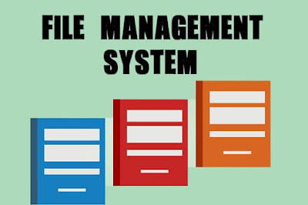
PROJECT OVERVIEW

Slide 4
The project is a File management System through which the user can perform some time-consuming tasks very quickly with uttermost ease and simplicity.
The main goal of the Application is to provide it’s users with one touch options to Display all the files present in the directory, to add a new File to the directory, to Delete a specified File from the directory, and to Search the directory for a specified File.
At every checkpoint of this application, the user is asked to enter the choice between exiting the application or to go back to the Main Menu.

Slide 5
ABOUT DEVELOPER
This application is created from scratch by Arshiya Saxena (B.Tech – EEE) who is currently pursuing a course on Full Stack Java Development from Simplilearn.

Slide 6
Sprints Planned

Slide 7
Sprint 1 ( 5 Days )
The Goal of this Sprint is to carefully understand the functional requirements of Lockers Pvt. Ltd.

Slide 8
Day 1 – Day 5
The project description received by Lockers Pvt. Ltd. was analyzed deeply to understand the problem statement.
The project is to create a file management system through which the user can perform some operations without going into the technicality of the system.
The user should be able to display all the files in the directory in ascending order, add a new file, delete a file, search for a file by name, and exit the application at will.
If the user ever inputs an invalid input, then he should not be thrown out of the application but rather get back to main menu everytime it happens.
The application should not throw an exception ever.

Slide 9
Sprint 2 (5 Days)
The goal of this sprint is to develop a functional prototype of the application and deliver to the client.

Slide 10
Day 6 – Day 10
After completely and carefully understanding the product requirement, the development is now underway.
The development will be done using Java Language on Eclipse IDE.
The main menu of the application is designed in a separate class and that class is to be called every time the user goes back to the main menu.
For every File function, a separate class is built in order to keep the complexity at the lowest.
A fully functional prototype is developed and delivered to the client.
The Client reviewed the prototype, and now wants several functional changes to be made, but approves the overall look and functions of the application.

Slide 11
Sprint 3 (5 Days)
The goal of this sprint is to make required changes in the application, test , and deliver the final product to the client.

Slide 12
As per the client requirements, the specific changes were made to the application, wherein, now the application will not create duplicate files.
The second prototype was delivered to the client and it got approved.
Final touches were done and the product was handed over to the testing team where it passed most of the tests but some bugs were discovered.
The development team successfully debugged the product andgot approval from the testing team.
The final product was delivered to Lockers Pvt. Ltd.

Slide 13
Application Algorithm
The Application would start by Welcoming the user, and then it will display the Main Menu to the user which would be to either Display all files in the directory in ascending order, or to show the file operations menu or to finally exit the application.
Then, according to the user input, the application would take the following action :
# first option to display all files in ascending order, and then ask user to exit or go back to menu.
# second option for file operations which consists of functionalities to add a file, delete a file, search for a file, go back to the main menu, or to exit application.
# third option to exit the application.

Slide 14
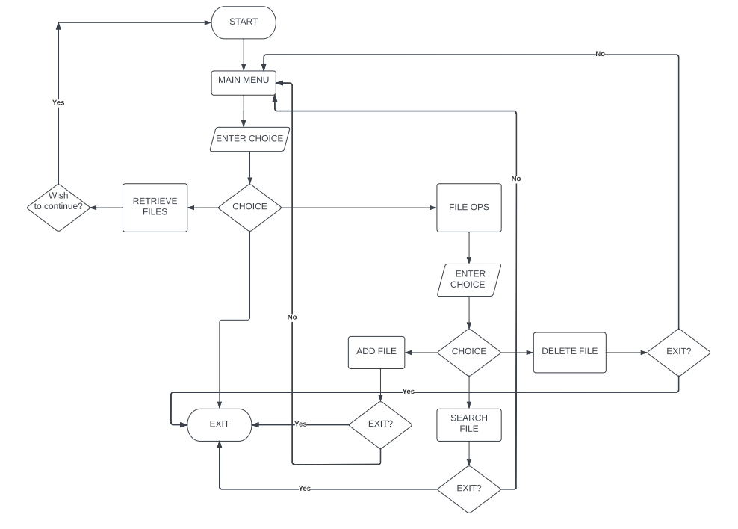
Flowchart

Slide 15
Core Concepts

Slide 16
File Handling : The modern file handing system consists of many functionalities under one concept.
Exception Handling : The concept of handling the runtime errors so that the normal flow of the application can be maintained.
Switch Case : A switch statement is used to select one of the many blocks in a program to be executed.
Classes : It is a logical entity that contains the methods and functions.
Objects : An object is an instance of a Class through which the user can call any class.
Sorting : Technique to sort the data according to the user’s requirement.
Collections : It is a framework in java that provides the developer with a number of readymade functions to use in a program.

Slide 17
GitHub Repository Link
https://github.com/arshiyasaxena/Simplilearn-Phase_1-LockedMeProject

Slide 18
Conclusion on Enhancing the Application
The future enhancements in this application can include a Graphical User Interface to make it more user friendly and easy to use.
Another enhancement that can be made is security enhancement, the application can be made Password protected to protect the integrity of the files and data in it.
The application can be made into a cloud hosted application which can help to manage the files saved in the user’s cloud.

Slide 19
Unique Selling Points
According to me, the USP of this application is that it provides the user with a one-stop solution for all file handling functions and the fact that the user can navigate easily inside the application after every method and will only exit the application when he desires.

Slide 20
Thank You

